Slide 1
Tutorial 3
Solving LP Model using Solver
QM for Windows
Prepared By:
Fatma Khedr

Slide 2
Question 2
Jack is an aspiring freshman at Ulern University. He realizes that “all work and no play make Jack a dull boy.” Jack wants to apportion his available time of about 10 hrs. a day between work and play. He estimates that play is twice as much fun as work. He also wants to study at least as much as he plays. However, Jack realizes that if he is going to get all his homework assignments done, he cannot play more than 4 hrs. a day. How should Jack allocate his time to maximize his pleasure from both work and play?

Slide 3
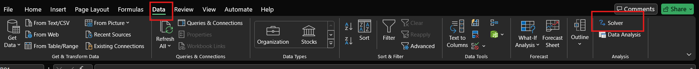
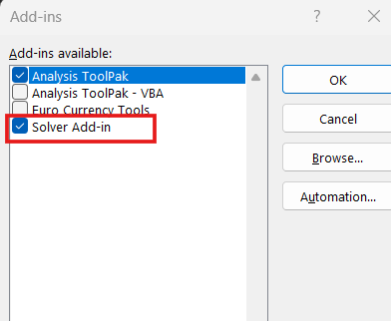
How to add solver in excel
It should appear whenever you open Excel
Open Excel
Click on File
Choose Options
Choose add-ins
Choose Solver add-ins
Choose Go Icon
OK

Slide 4
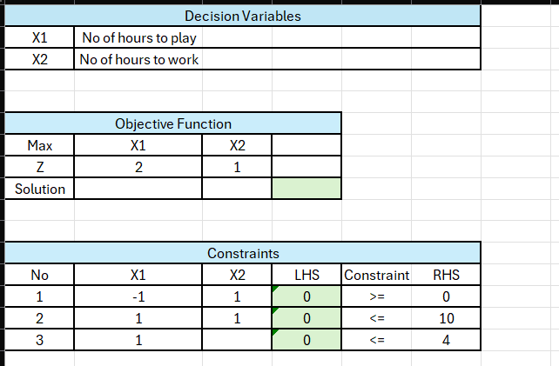
Solution
Prepare your workbook by defining:
Decision Variables
Objective Function
Constraints

Slide 5
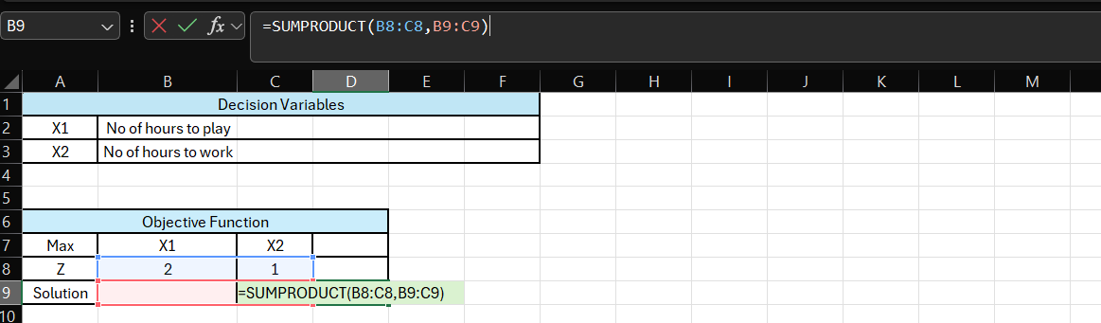
For the objective function:
Use sum product function (prepare this equation in the green cell)
The first array will be the Z Row, and the second array will be the empty cells.
We are using sum product because any solution should be multiplied by its coefficient.

Slide 6
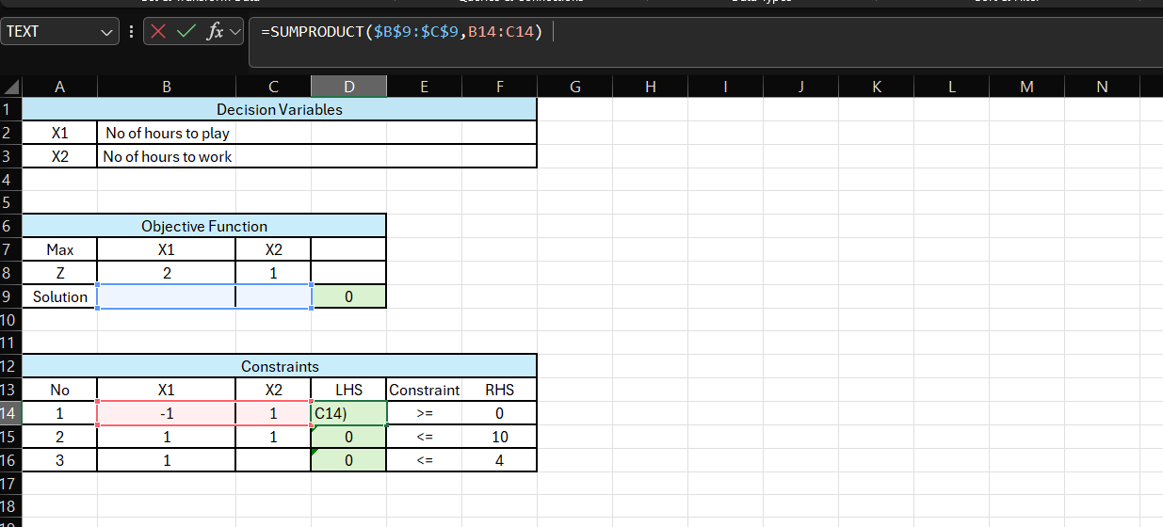
Constraints Equation
In LHS, Sum product:
Choose the empty cells in the objective function, then click Fn+F4 or F4 for the dollar sign (this sign means that the empty cells will remain constant whenever you drag any equation), for the second array choose the row of X1 & X2, then drag downwards.

Slide 7
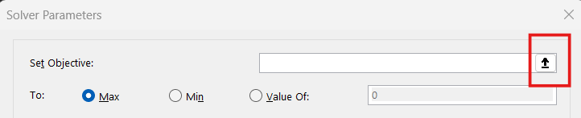
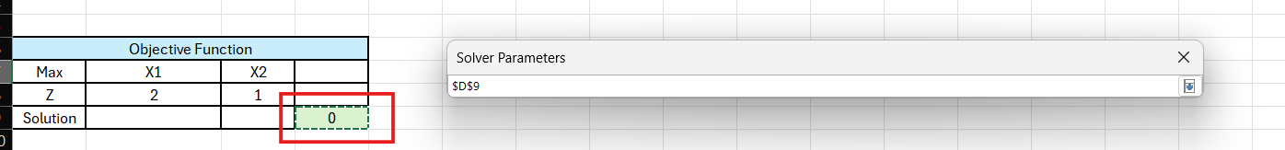
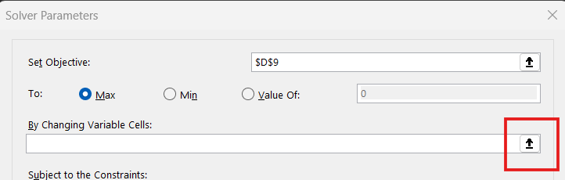
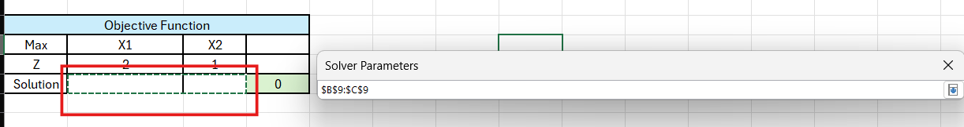
Click on Solver
Set Your Objective by choosing the green cell
Set your Variable Cells by choosing the empty cells.

Slide 8
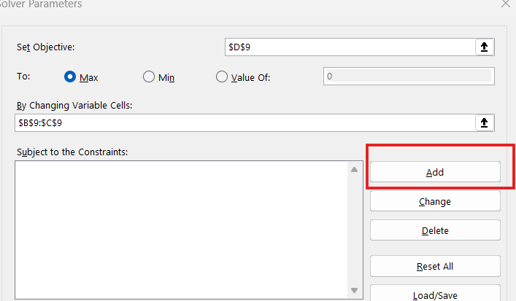
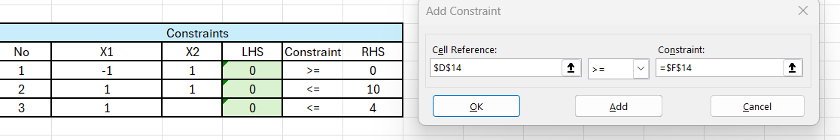
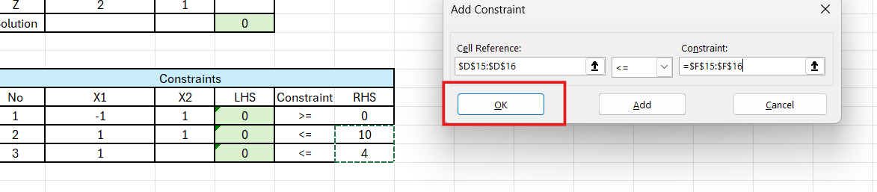
Click on Add to add your model constraints
For constraint 1, the cell reference should be the LHS cell, constraint will be RHS, then click on add to add the remaining constraints
For constraint 2 & 3, since both are having the same constraint (<=), we can add them together.
Cell reference will be the LHS (Drag the remaining two), and constraint will be the RHS (Drag)
Then click OK

Slide 9
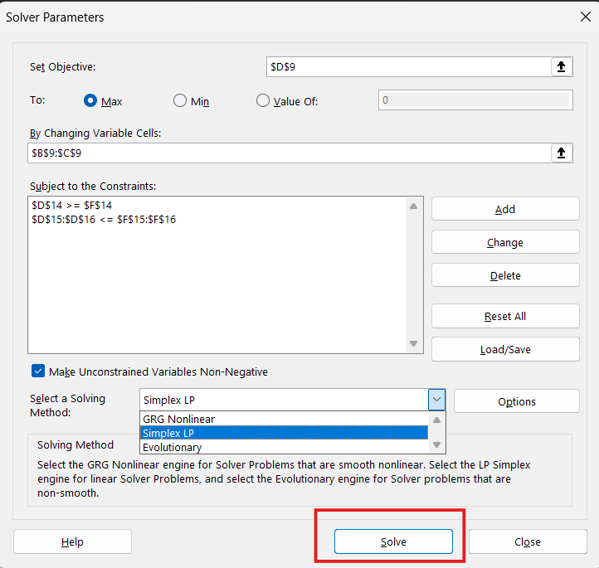
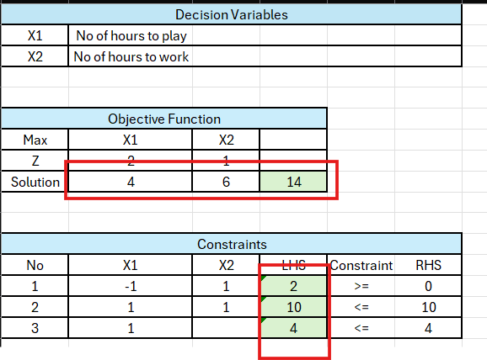
Solution
Click on: Make unconstrained variables Non-negative (Non-negativity constraint)
Solving Method: Simplex LP
Solve

Slide 10
Solution
Analysis:
Jack should play for 4 hours and work for 6 hours
LHS equations means that when you substitute with 4 & 6, the values will fit the constraints.

Slide 11
Question 3

Slide 12
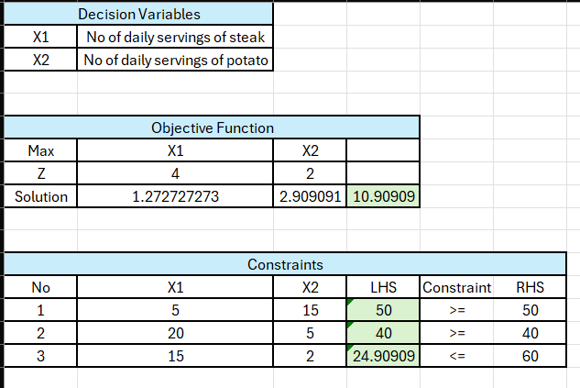
Solution (Same Steps, except your minimizing so choose Min not Max

Slide 13
Question 4
The New England Cheese Company produces two cheese spreads by blending mild cheddar cheese with extra sharp cheddar cheese. The cheese spreads are packaged in 12-ounce containers, which are then sold to distributors throughout the Northeast. The Regular blend contains 80% mild cheddar and 20% extra sharp, and the Zesty blend contains 60% mild cheddar and 40% extra sharp. This year, a local dairy cooperative offered to provide up to 8100 pounds of mild cheddar cheese for $1.20 per pound and up to 3000 pounds of extra sharp cheddar cheese for $1.40 per pound. The cost to blend and package the cheese spreads, excluding the cost of the cheese, is $0.20 per container. If each container of Regular is sold for $1.95 and each container of Zesty is sold for $2.20, how many containers of Regular and Zesty should New England Cheese produce?

Slide 14
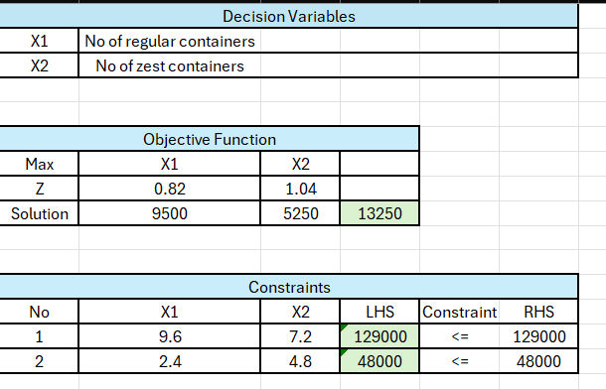
Solution

Slide 15
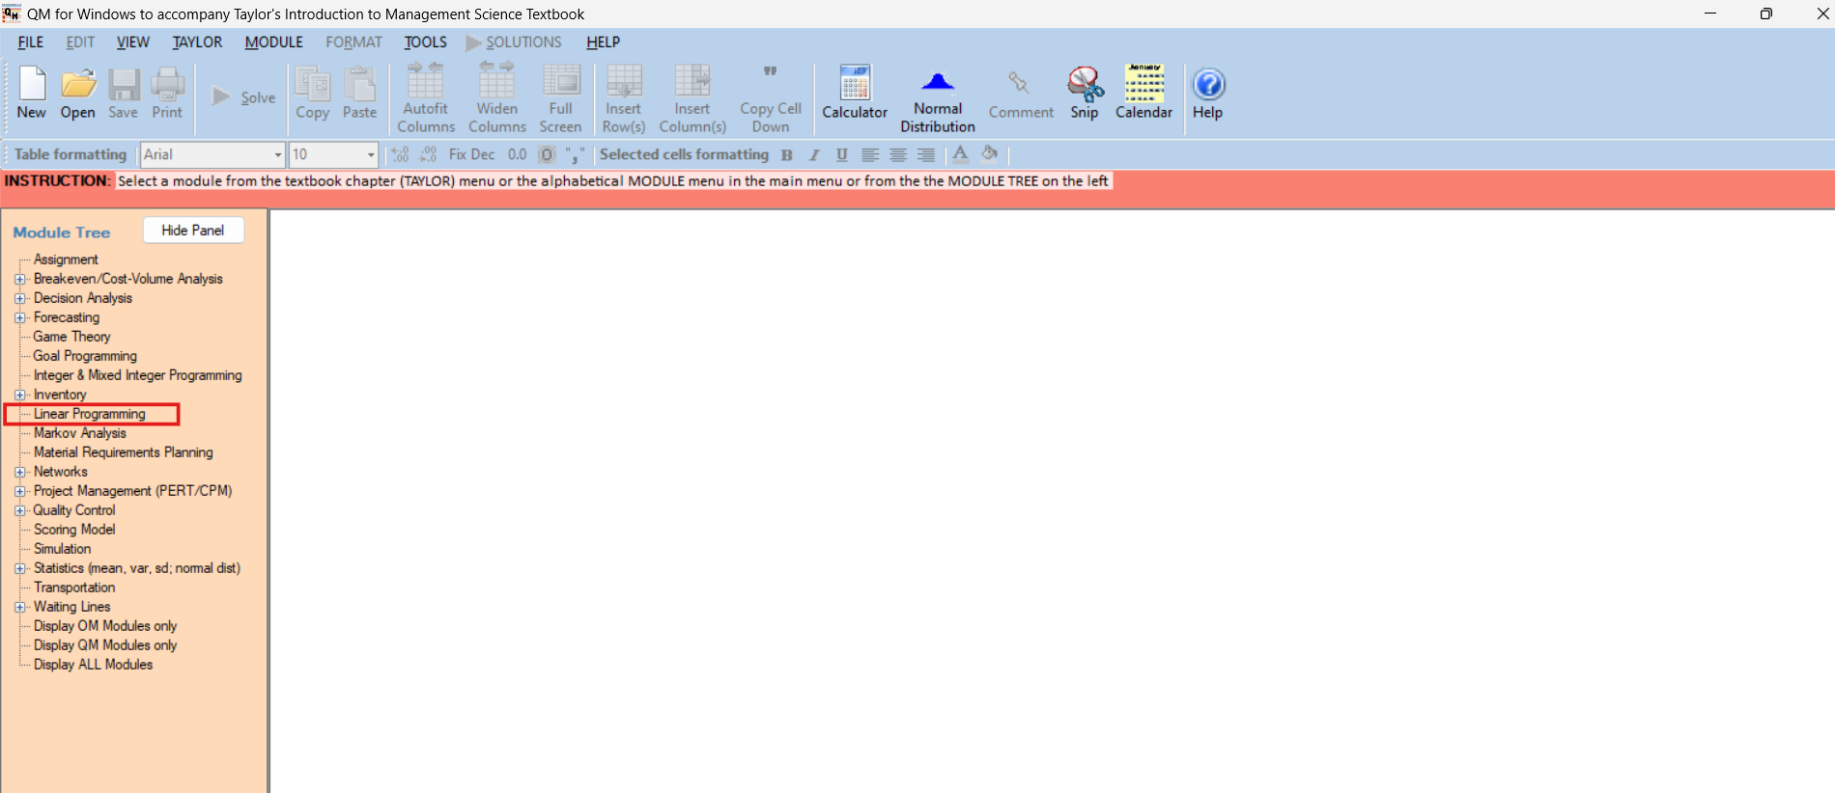
QM For Windows Solution (Question 3)

Slide 16
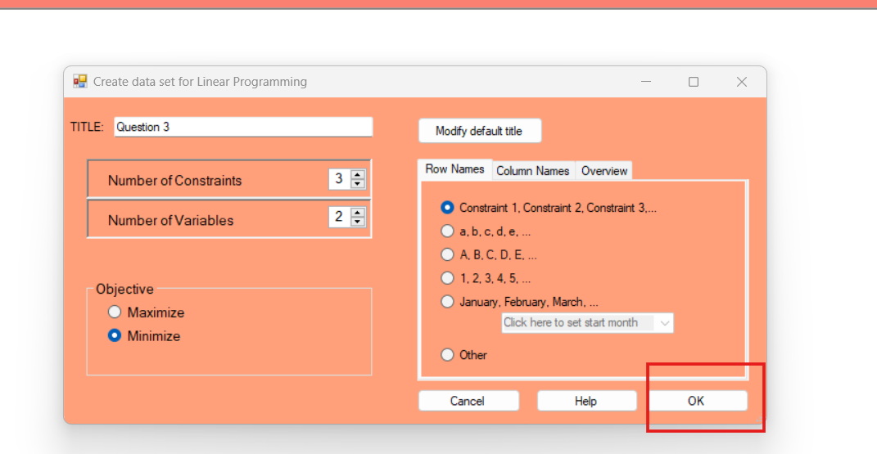
Define number of constraints, variables, and objective function

Slide 17
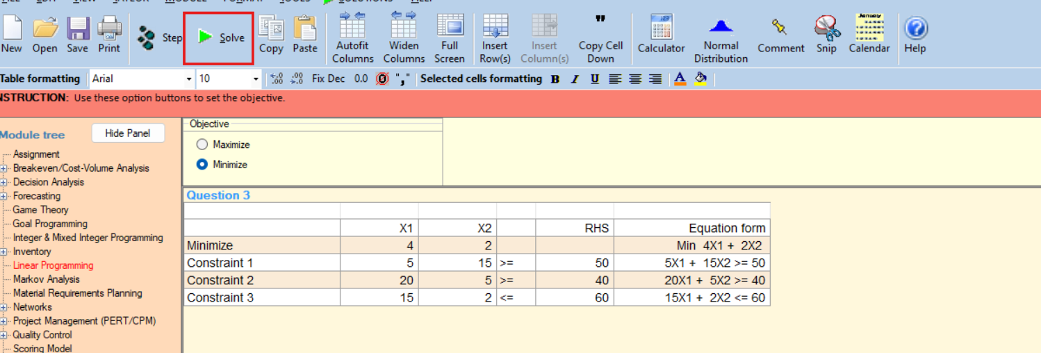
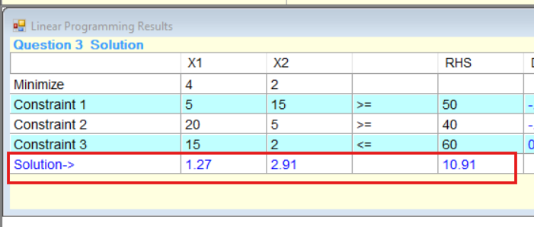

Slide 18
Classwork
Solve Question 2 & 4 by QM for Windows,

Slide 19
Thank You !

